Slide 1





How do resource abundance and stochasticity affect animal movement?
Stefano Mezzini – Ph.D. Biol.

Slide 2

Why do animals move?
Searching for food/nutrients
Searching for water
Searching for new den/nest
Searching for mate/group
Escaping predators/competitors
Defending resources/territory
Can measure HR instead of individual needs

Slide 3
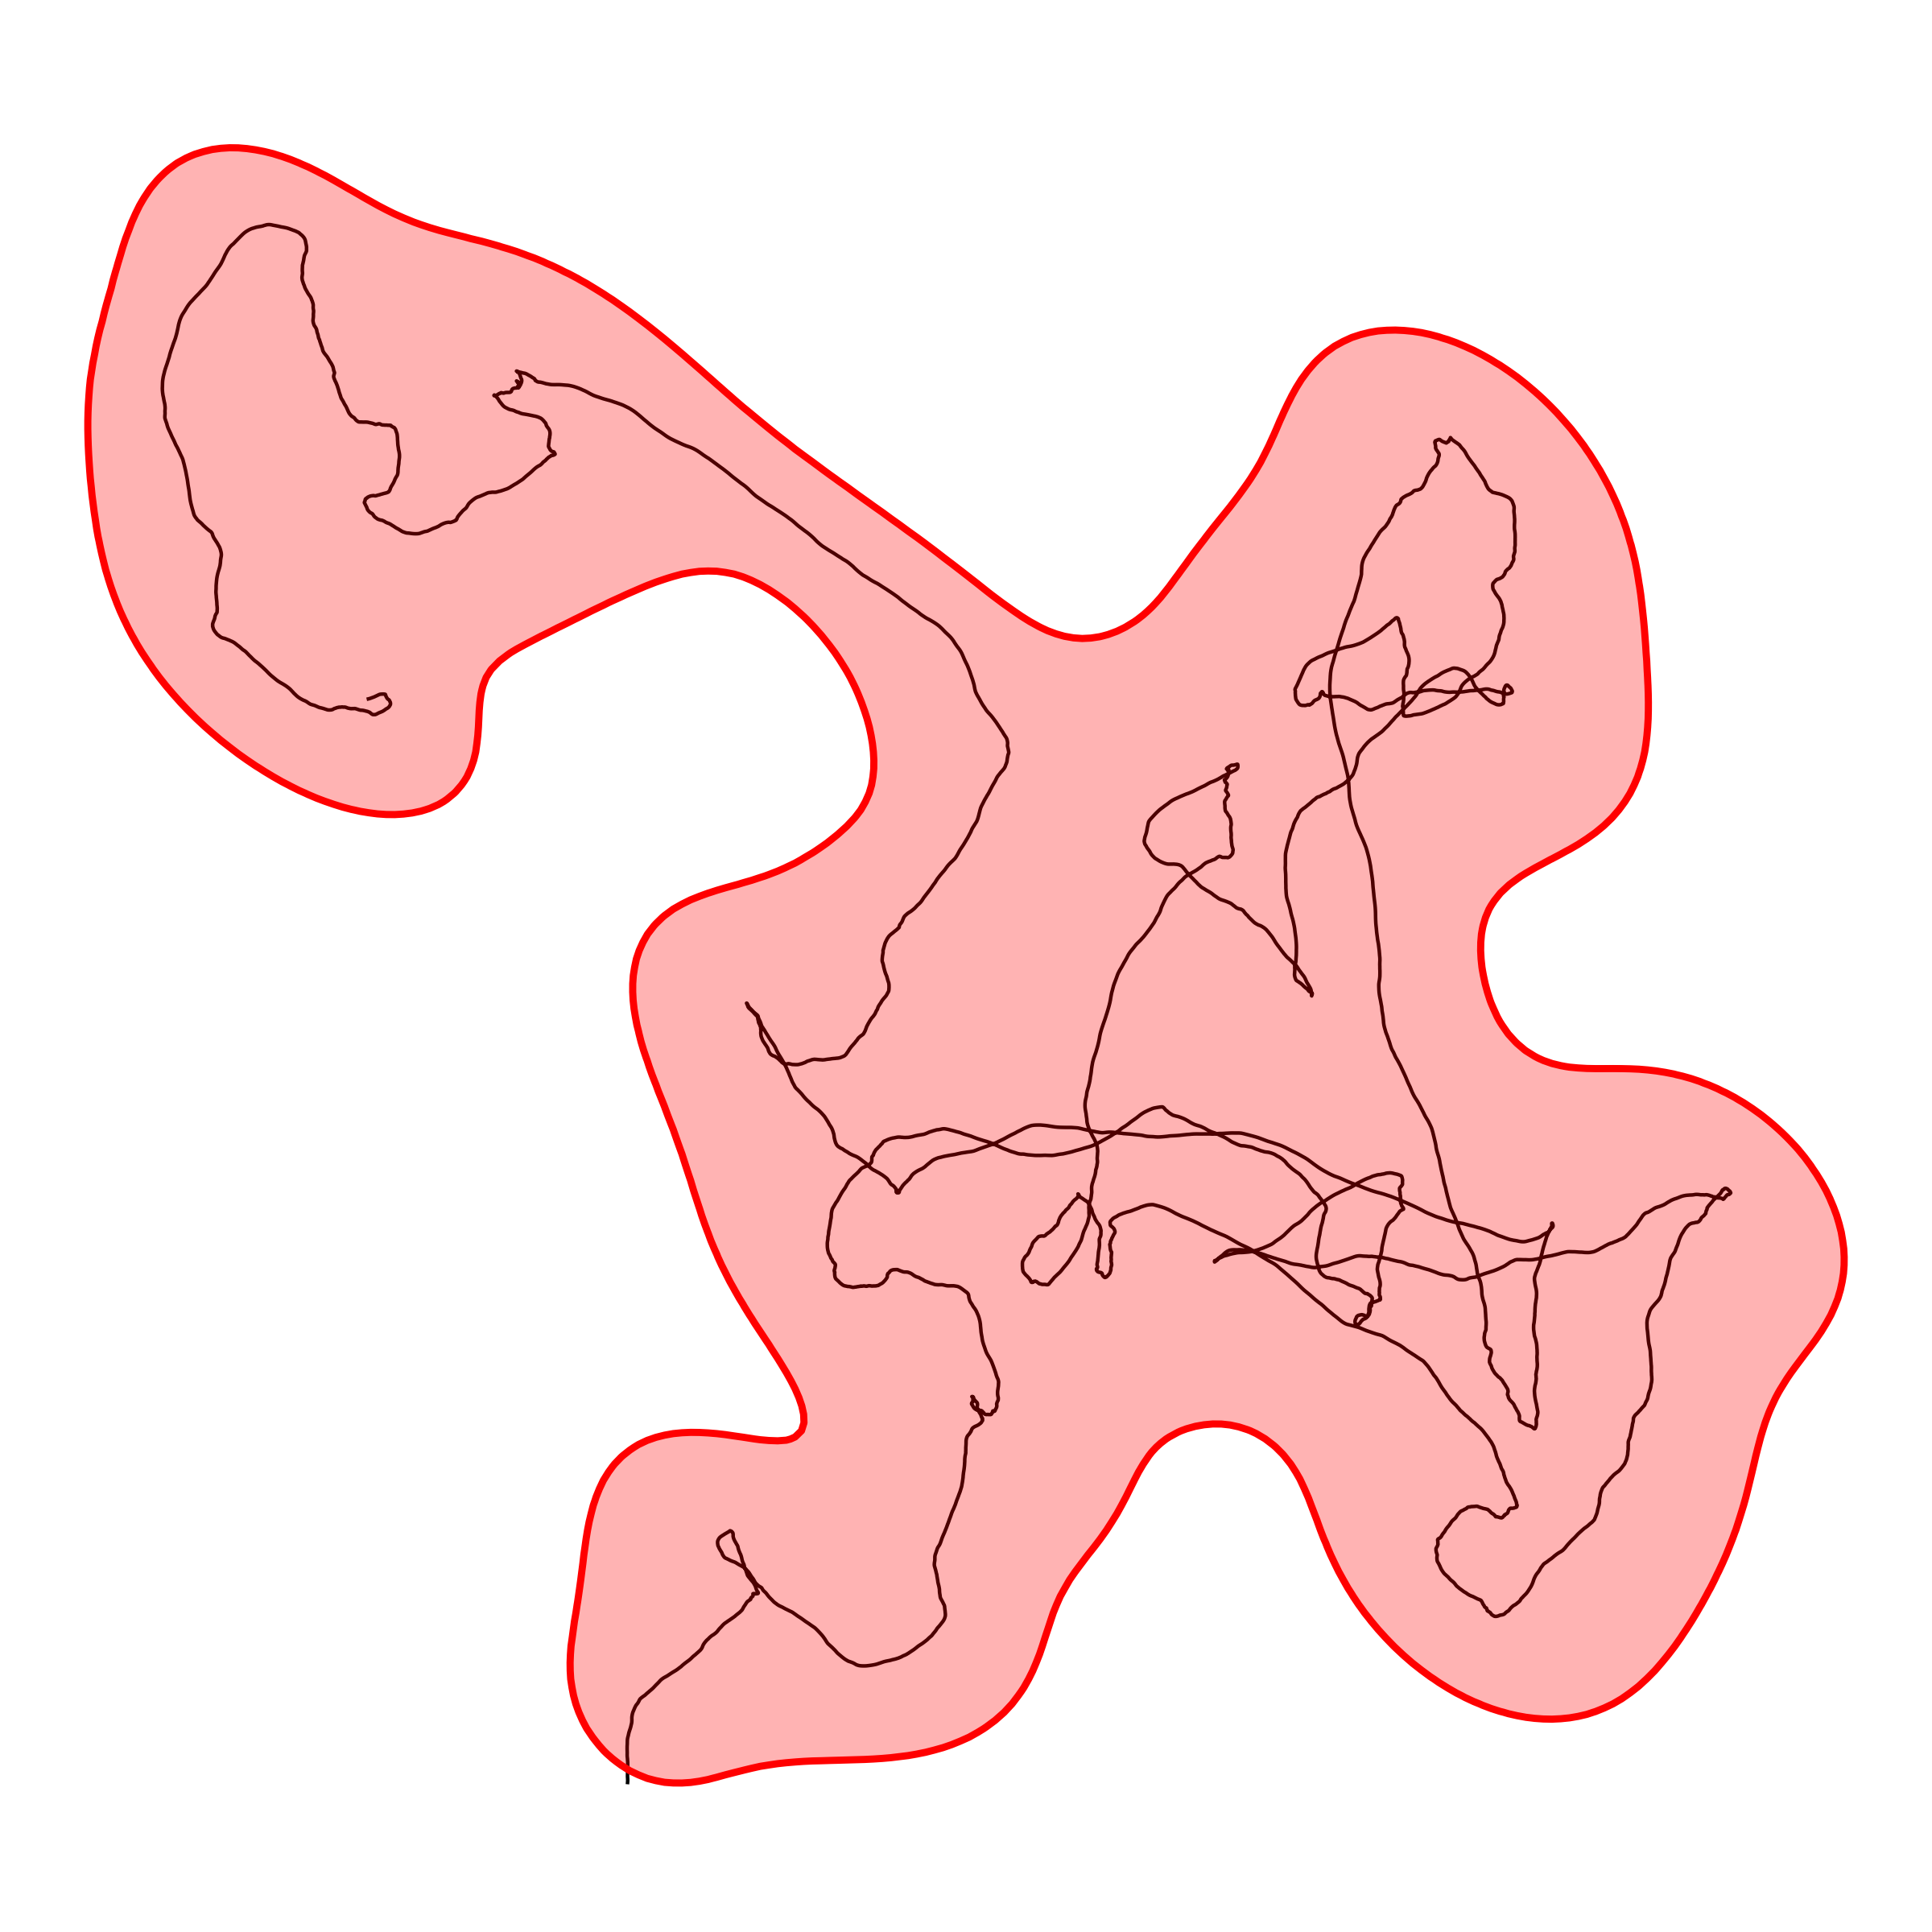
What is a home range?
Area required for essential needs
Animals must be range-resident
HR must have a stable centroid
Not applicable to:
Nomadic animals
Migrating animals
May change over time
Does not include exploratory movement

Slide 4
HR modeling requires a stable centroid
An eagle returning to its nest
A bear returning to its den
A bee returning to its hive
The center of a coyote’s hunting grounds
The center of a deer’s foraging grounds

Slide 5
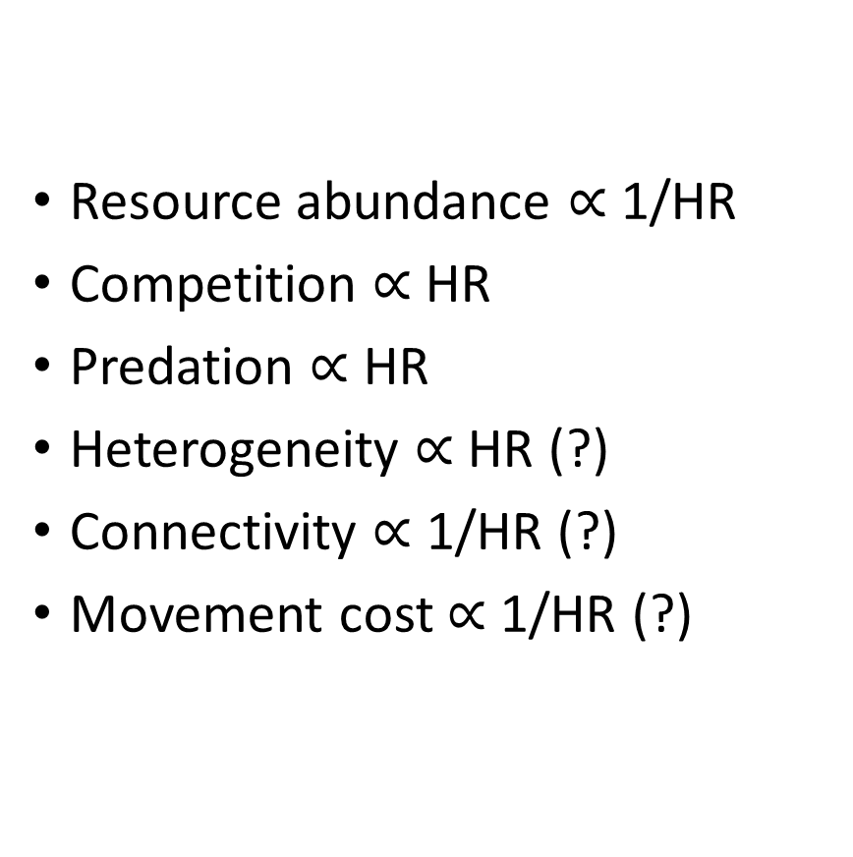
What might affect HR size?
Resource abundance $∝$ 1/HR
Competition $∝$ HR
Predation $∝$ HR
Heterogeneity $∝$ HR (?)
Connectivity $∝$ 1/HR (?)
Movement cost $∝$ 1/HR (?)

Slide 6
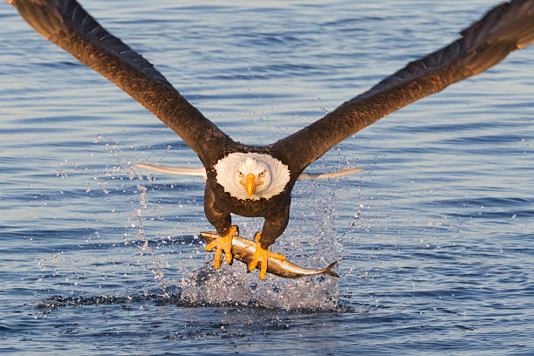
Resource abundance and HR: examples
An eagle nests near areas with high prey density
Bald eagle, photo by KenCanning

Slide 7
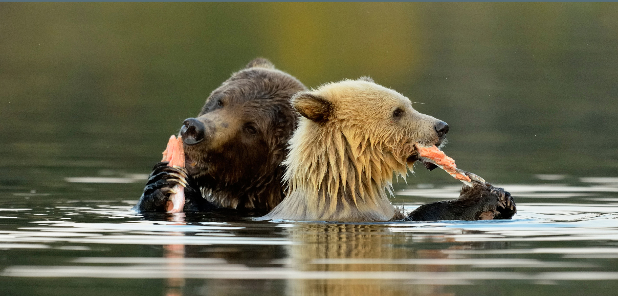
Resource abundance and HR: examples
A bear stays near a river where salmon spawn
Bears eating salmon,
https://hakaimagazine.com/wp-content/uploads/header-inland-salmon.jpg

Slide 8
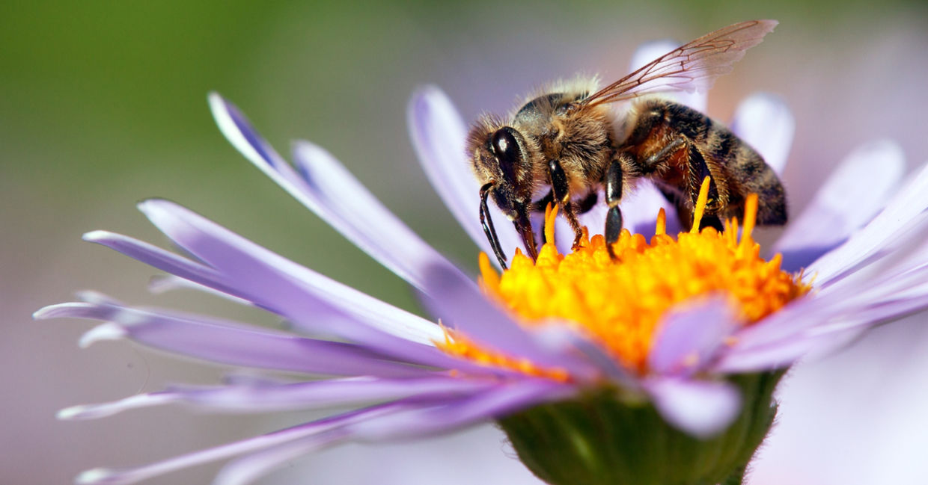
Resource abundance and HR: examples
A bee focuses on wildflower patches and ignores crops
Bee pollinating a wild flower,
https://www.goodnet.org/photos/620x0/29855_hd.jpg

Slide 9
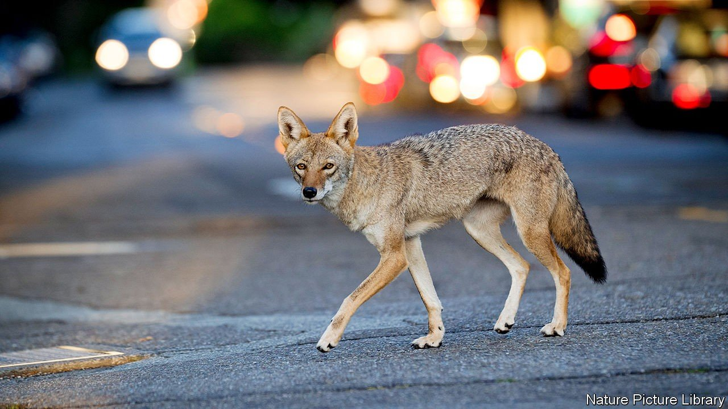
Resource abundance and HR: examples
A coyote takes advantage of pet food
Coyote in an urban environment,
https://www.economist.com/img/b/1280/720/90/sites/default/files/20200118_USP002.jpg

Slide 10
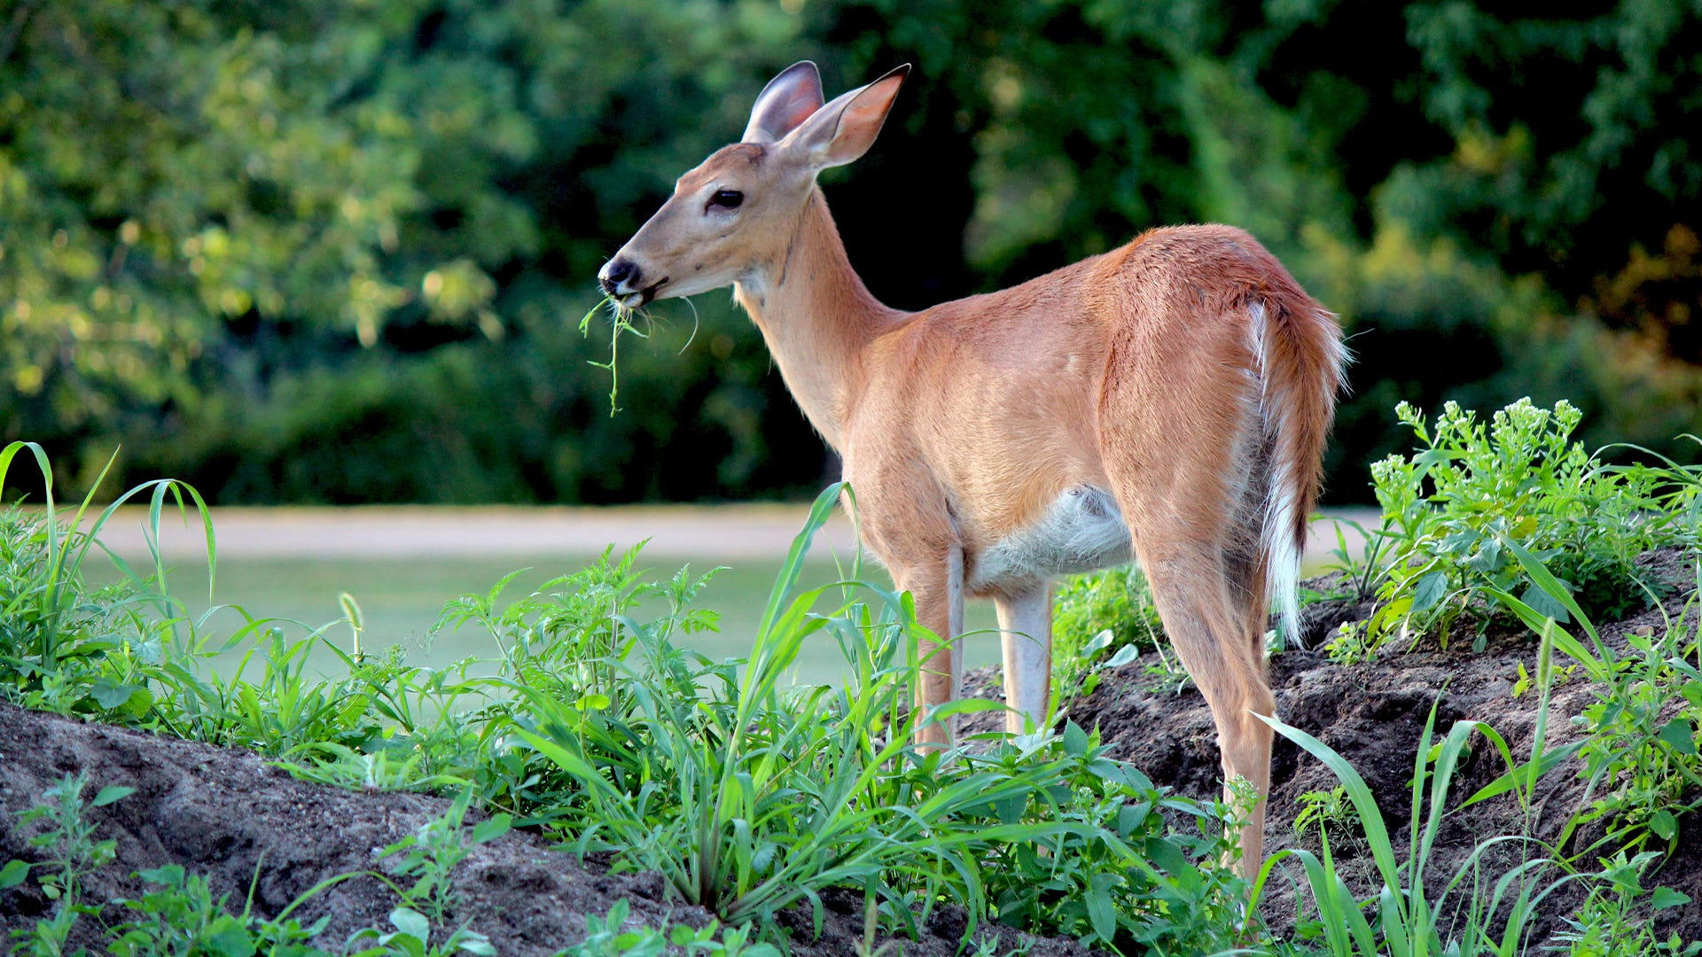
Resource abundance and HR: examples
A deer only stops at vegetation-rich patches
Foraging deer,
https://www.havahart.com/media/Articles/Havahart/Protecting-Plants-from-Deer.jpg

Slide 11
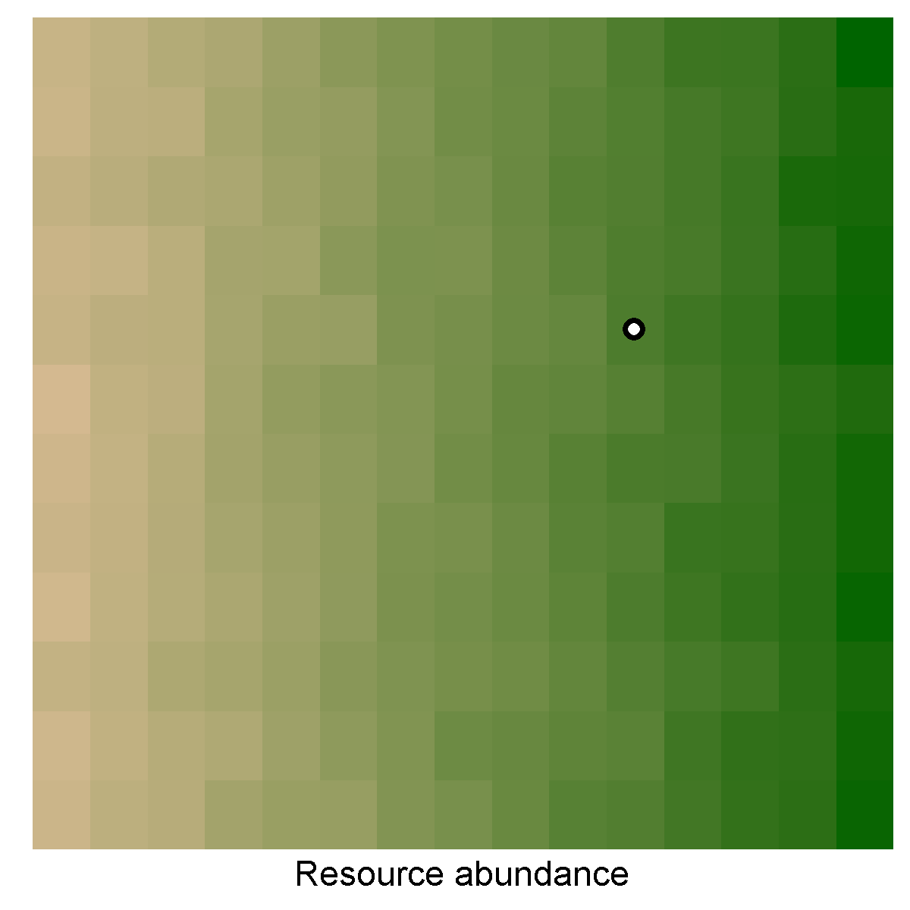
Resource abundance and HR: simulating movement

Slide 12
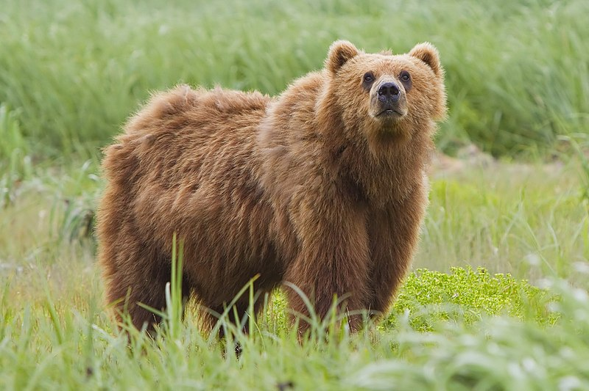
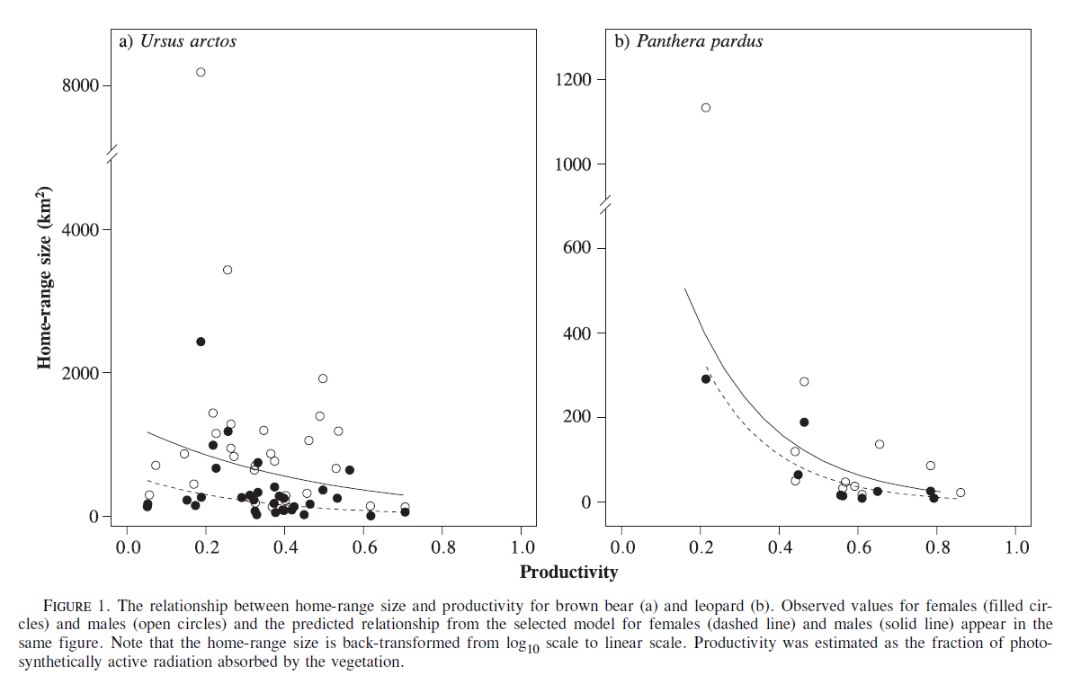
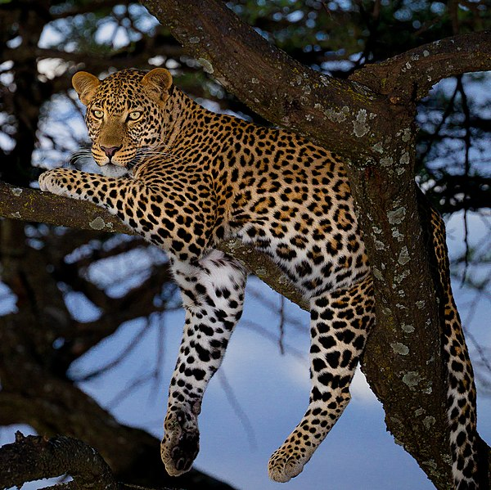
Resource abundance and HR: examples in literature
Brown bear,
Photo by Yathin S Krishnappa
(Nilsen et al. 2005)
Leopard,
Photo by Sumeet Moghe

Slide 13
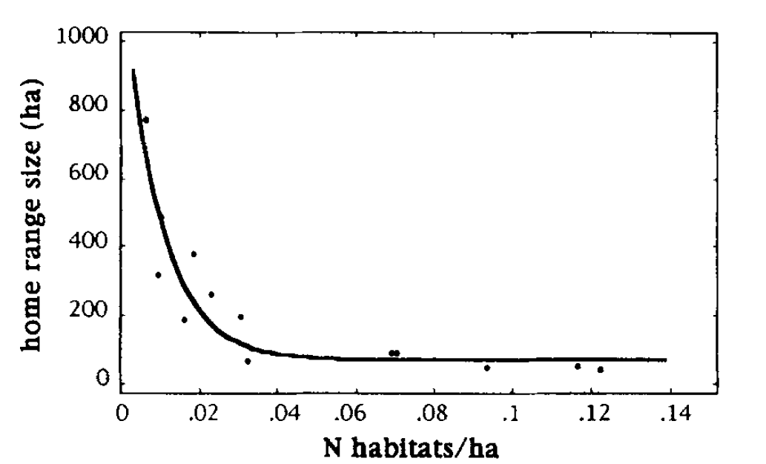
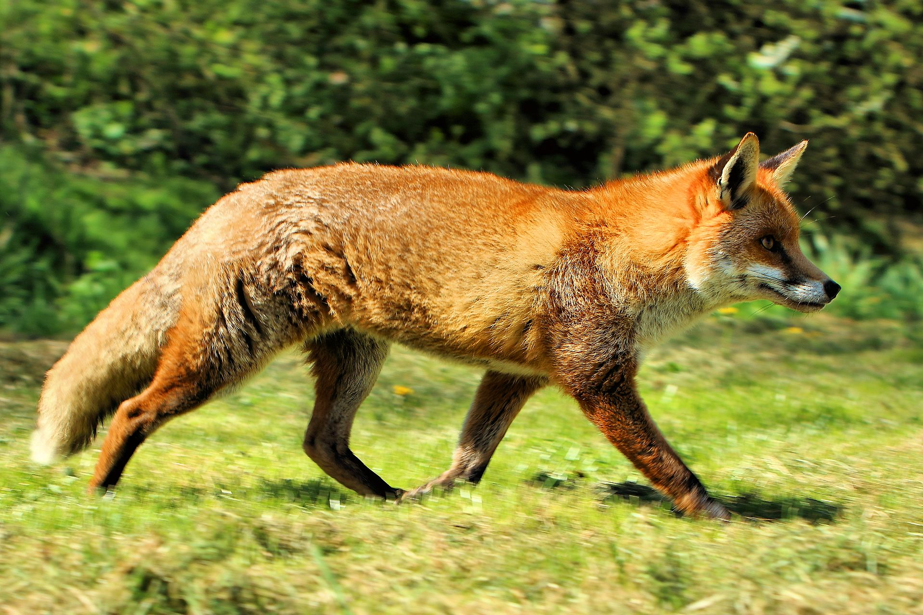
Resource abundance and HR: examples in literature
Red fox, photo by Airwolfhound
(Lucherini & Lovari 1996)

Slide 14
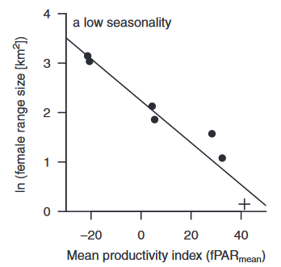
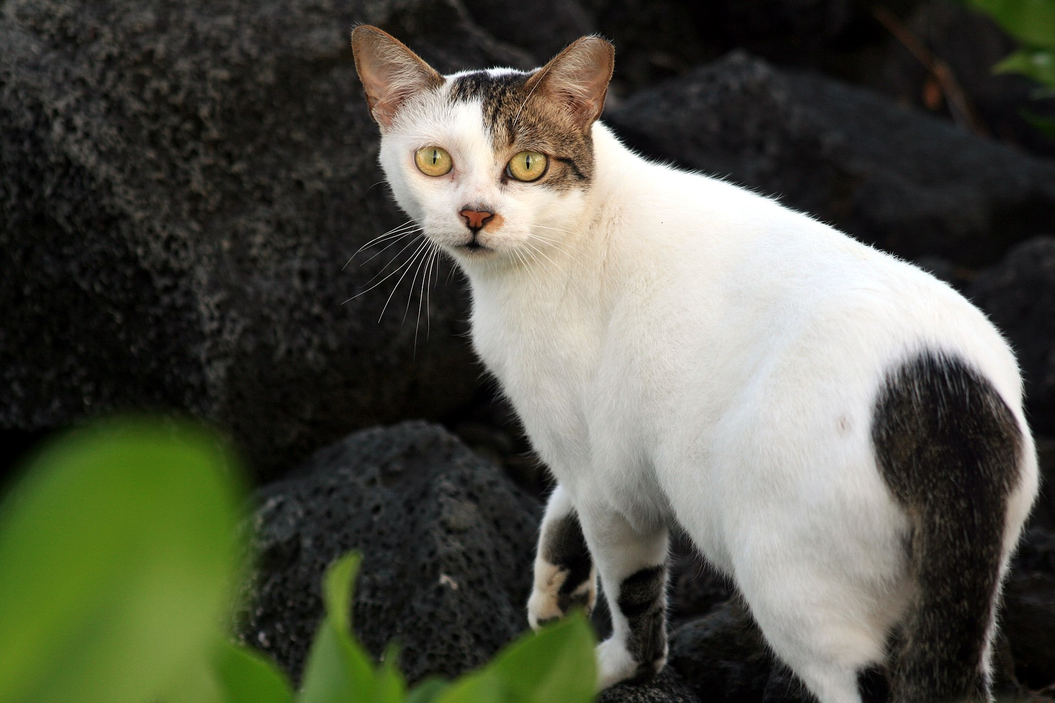
Resource abundance and HR: examples in literature
Outdoor or feral cat, photo by Brocken Inaglory
(Bengsen et al. 2015)

Slide 15
Environmental variance is also important
Heterogeneity:
Different habitats (forest, grassland, lake…)
Seasonal changes (temperature, precipitation, light)
Stochasticity:
Extreme and rare events (fire, flood)
Climate change

Slide 16
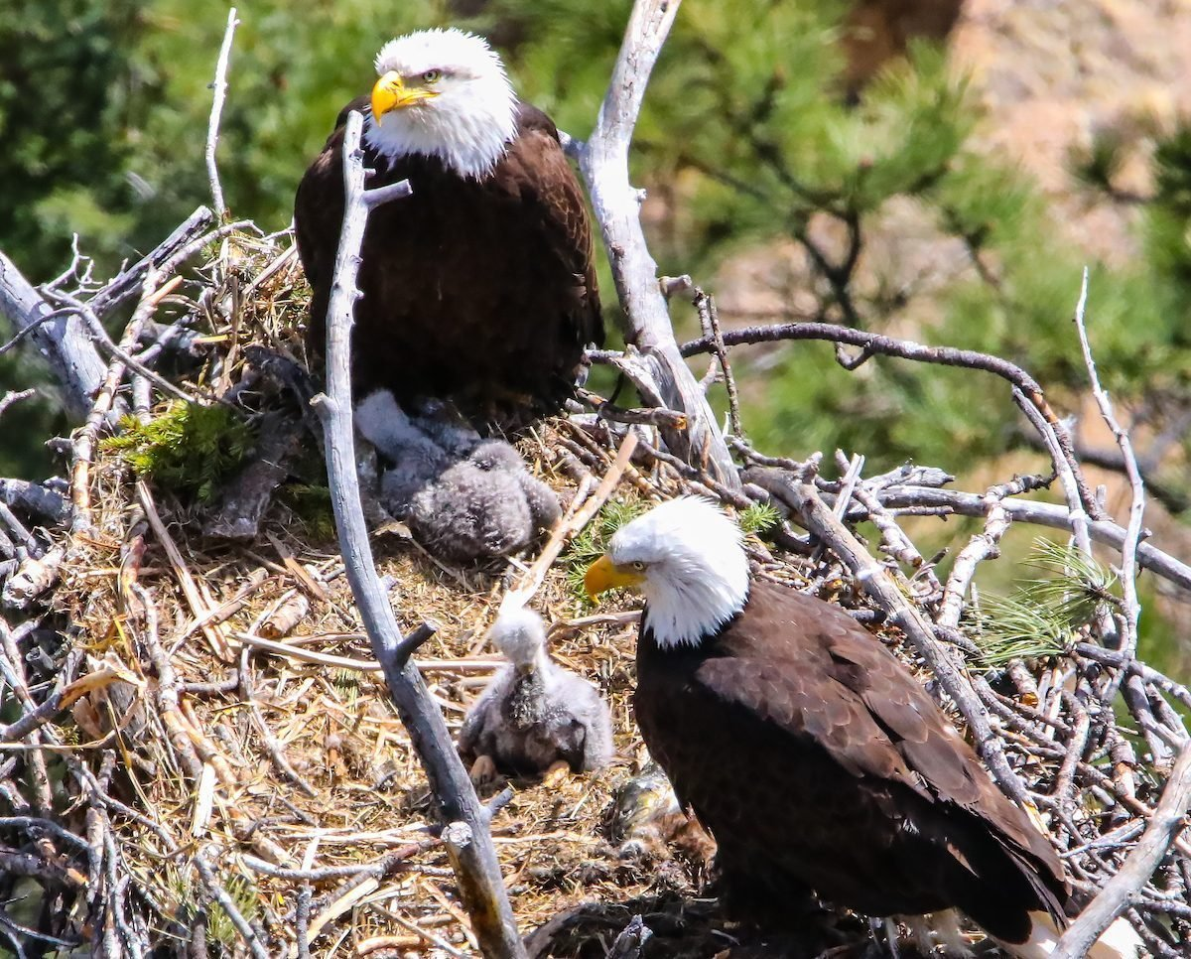
Variance and HR: examples
A pair of eagles nests near forest edges to be near the open grassland
Nesting bald eagles with chicks,
https://www.birdsandblooms.com/wp-content/uploads/2017/05/eaglenest_tonya-sharp-e1638205400987.jpg

Slide 17
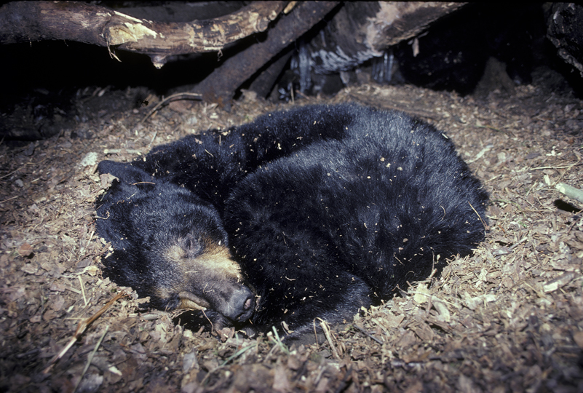
Variance and HR: examples
A bear hibernates in winter and visits the river when salmon spawn
Hibernating black bear,
https://bear.org/wp-content/uploads/2008/10/bear_curled_up_in_den.jpg

Slide 18
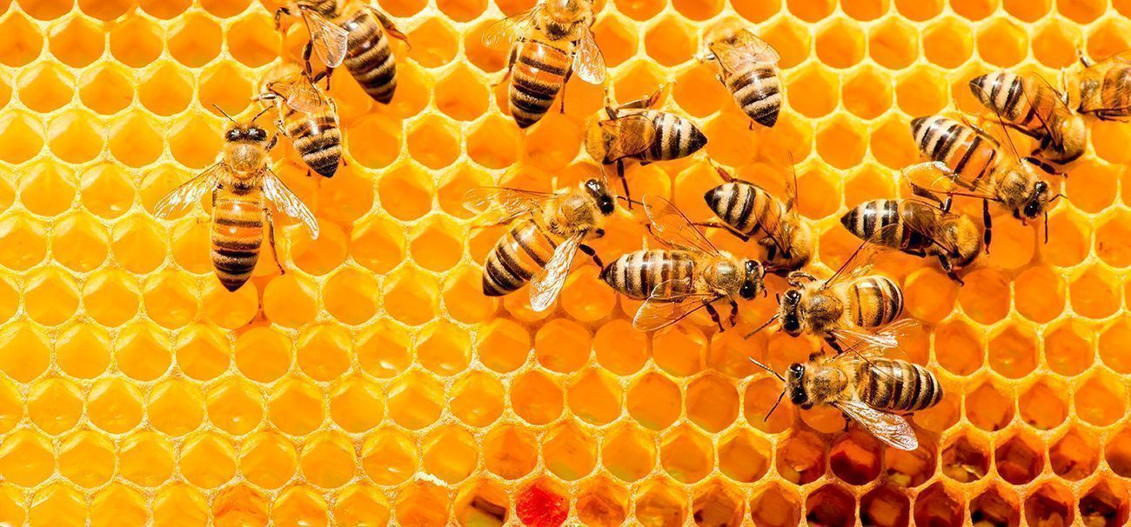
Variance and HR: examples
A bee only leaves the nest when it’s dry, warm, and not windy
Bees on honeycomb,
https://www.zooportraits.com/wp-content/uploads/2017/03/bees.jpg

Slide 19
Variance and HR: examples
A coyote takes advantage of the feeding schedule of pets
Coyote in an urban environment,
https://www.economist.com/img/b/1280/720/90/sites/default/files/20200118_USP002.jpg

Slide 20
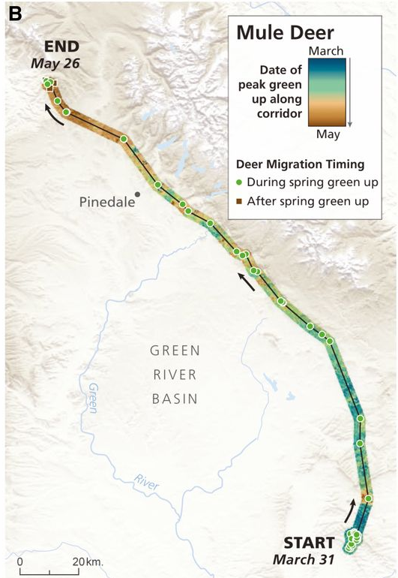
Variance and HR: examples
(Geremia et al. 2019)
A deer surfs the green wave
Foraging deer,
https://www.havahart.com/media/Articles/Havahart/Protecting-Plants-from-Deer.jpg

Slide 21
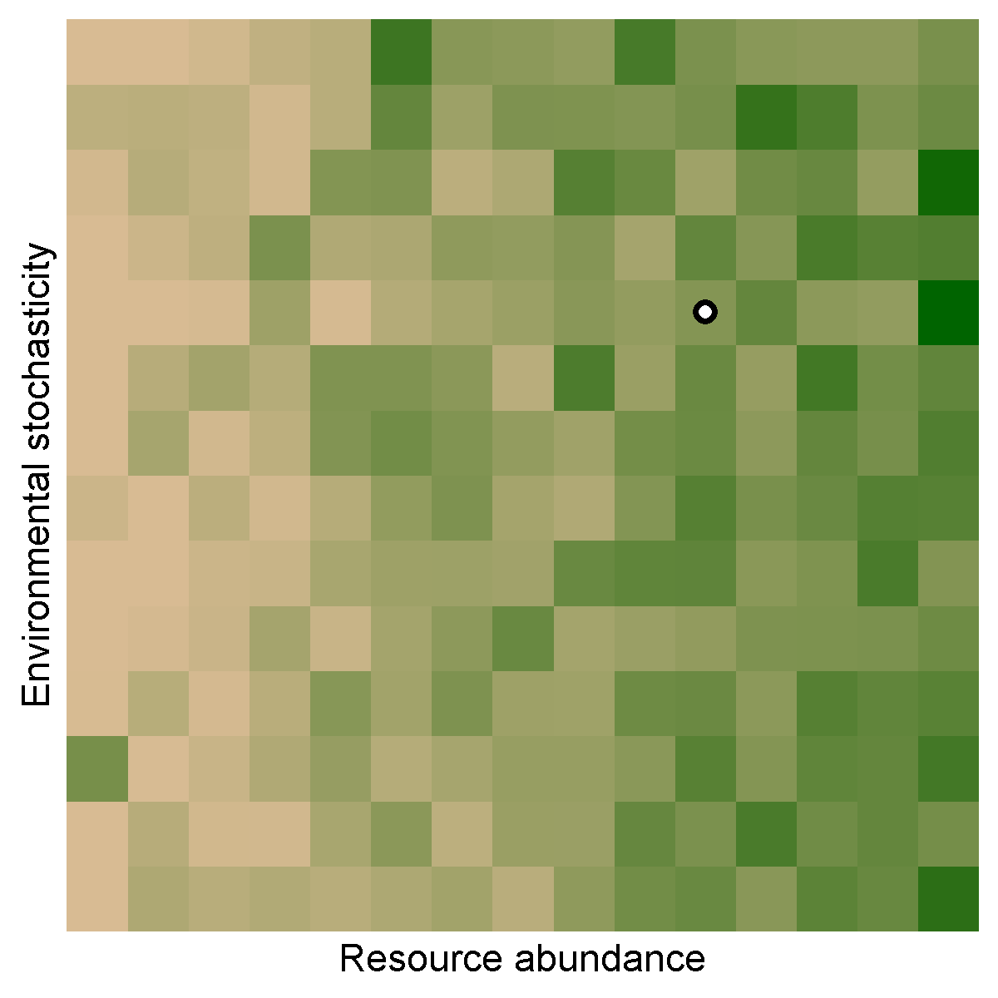
Variance and HR: simulating movement

Slide 22
Variance and HR: examples in literature
Red fox, photo by Airwolfhound
(Lucherini & Lovari 1996)

Slide 23
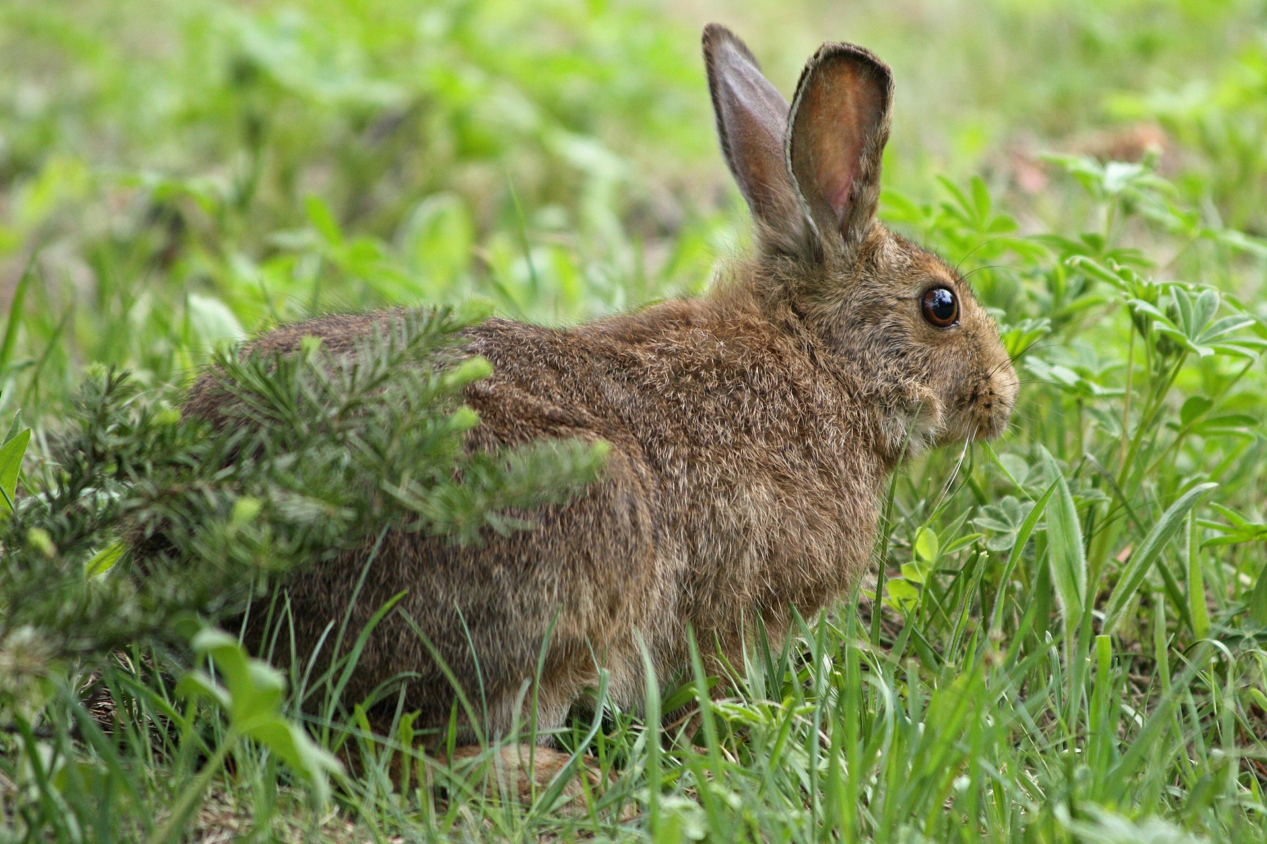
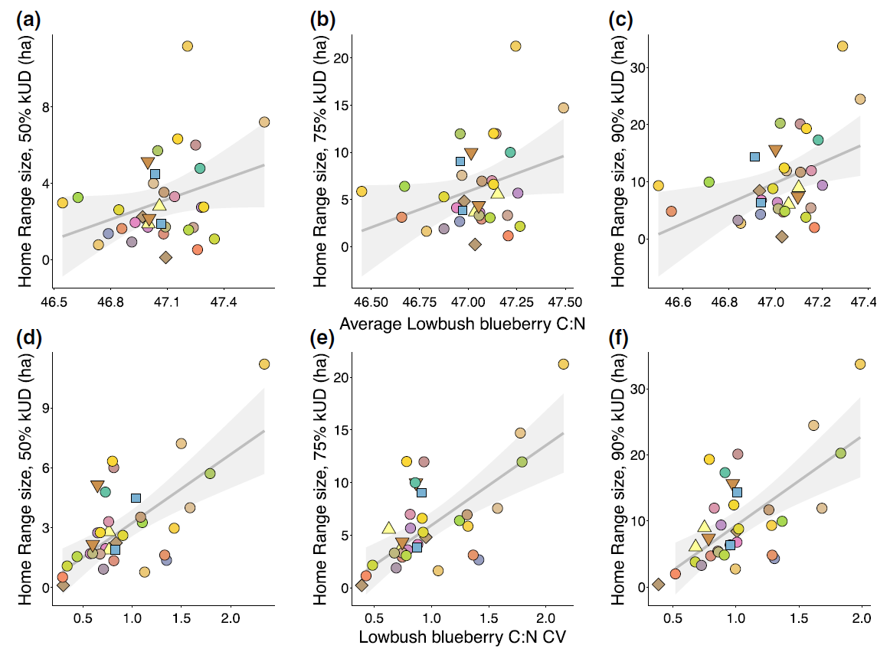
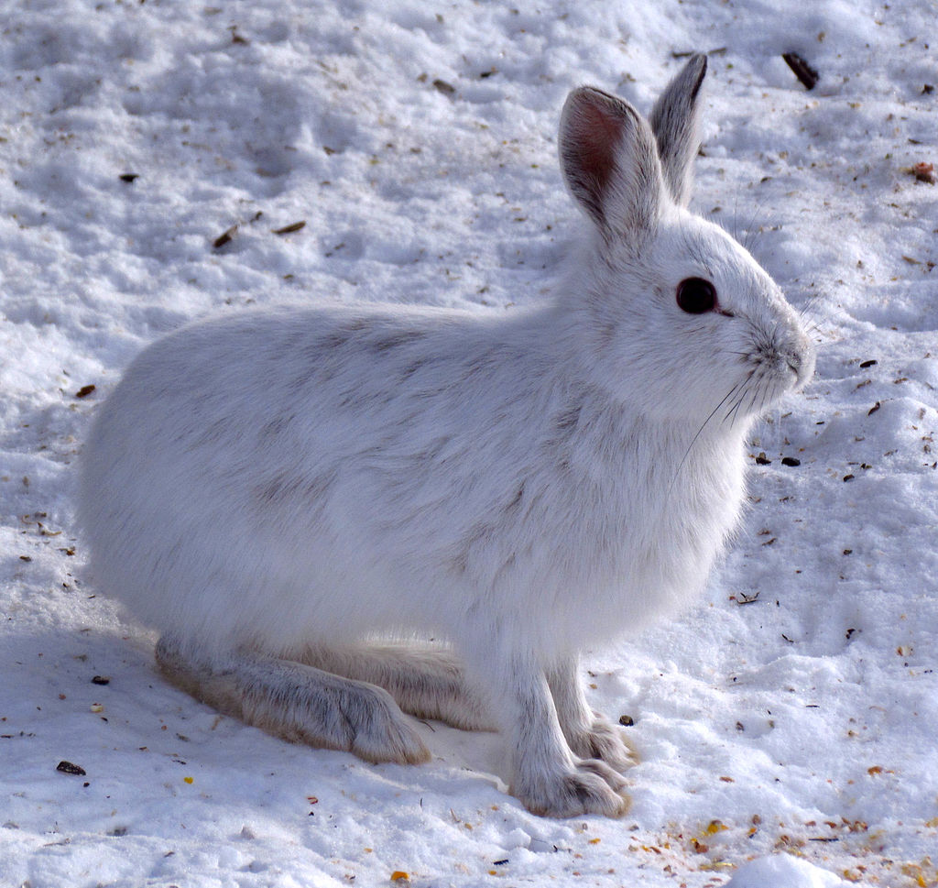
Variance and HR: examples in literature
Showshoe hares,
photos by Wsiegmund (modified) and D. Gordon E. Robertson
(Rizzuto et al. 2021)

Slide 24
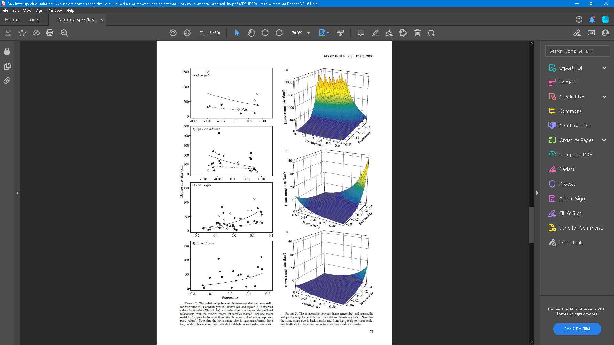
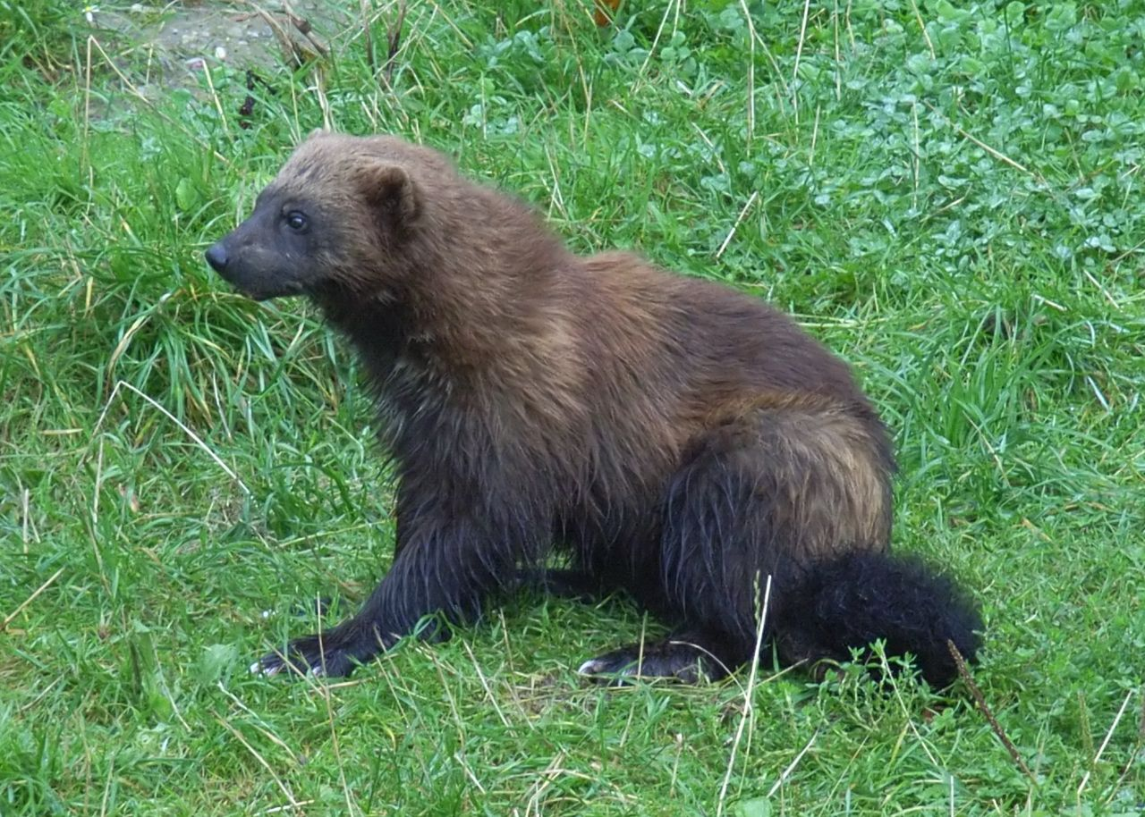
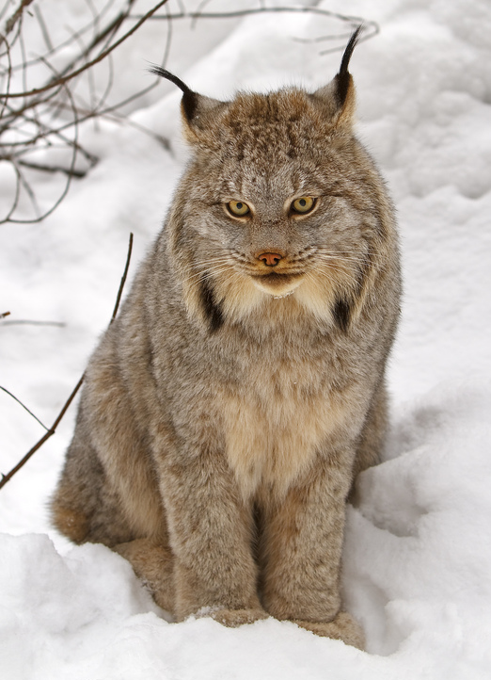
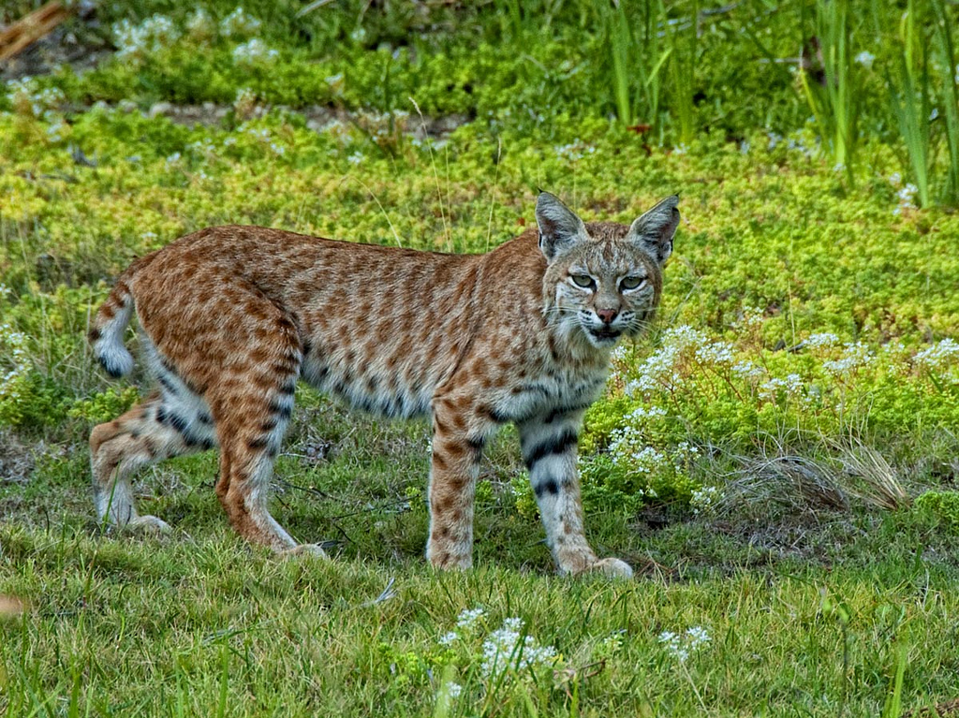
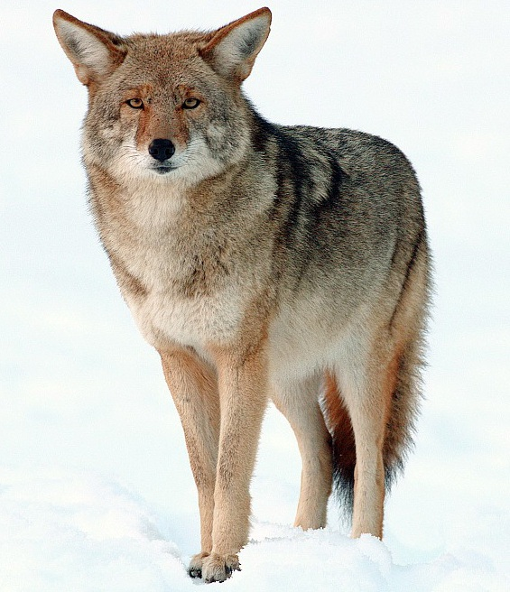
Variance and HR: examples in literature
Canadian lynx,
photo by Michael Zahra
Wolverine, photo by Zefram
Coyote,
photo by Yathin S. Krishnappa
Bobcat, photo by Bill W. Ca
(Nilsen et al. 2005)

Slide 25
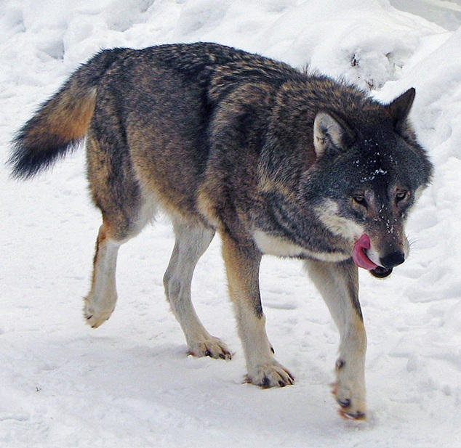
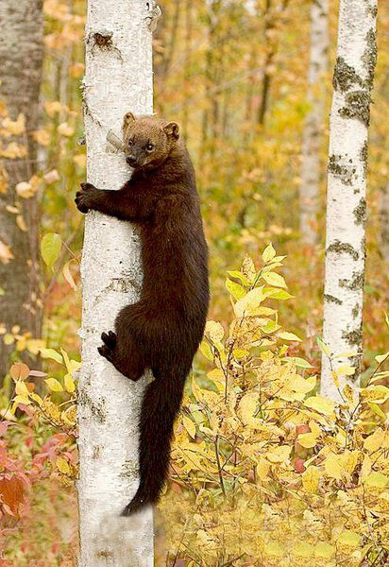
Variance and HR: examples in literature
Wolf, photo by Daniel Mott
Fisher,
photo by Douglas H. Domedion
(Nilsen et al. 2005)

Slide 26
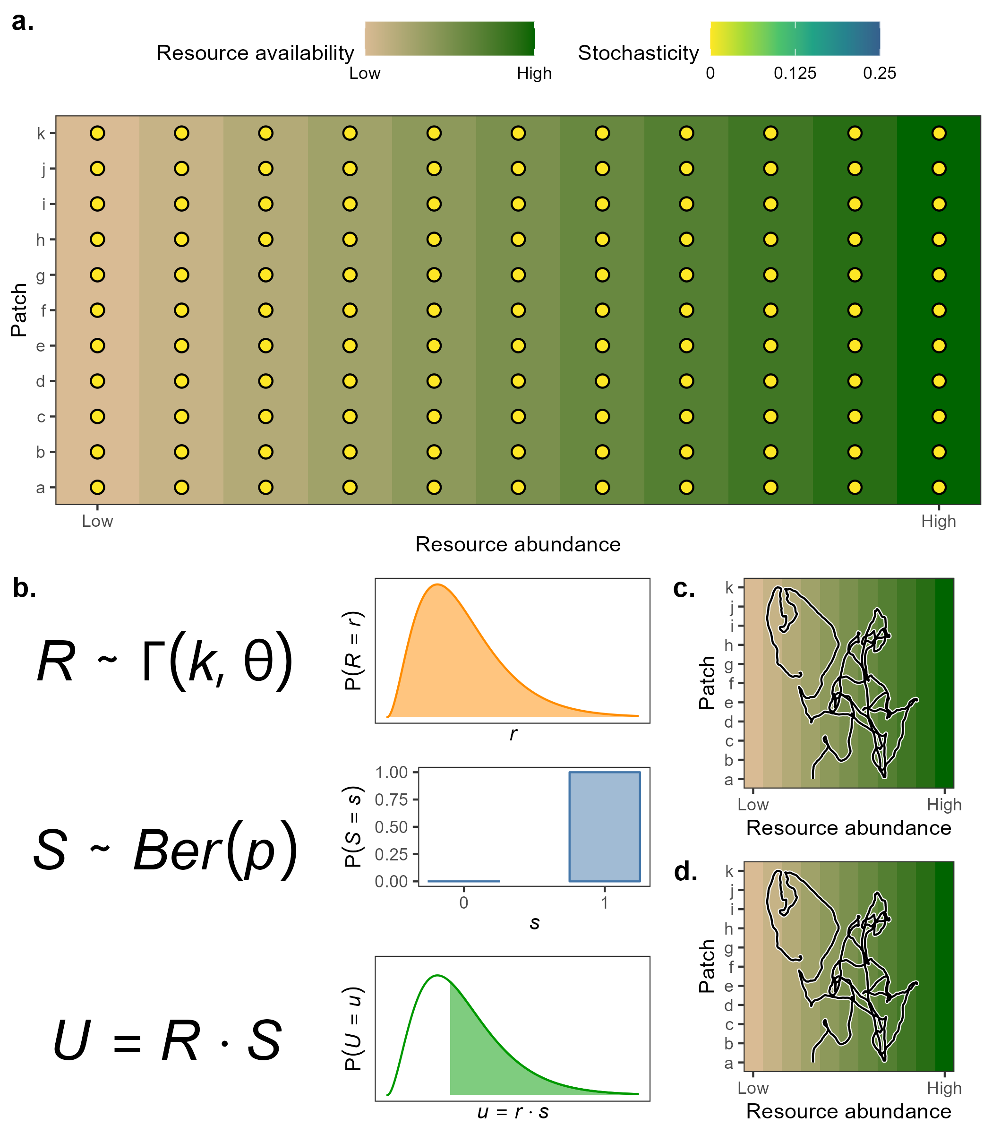
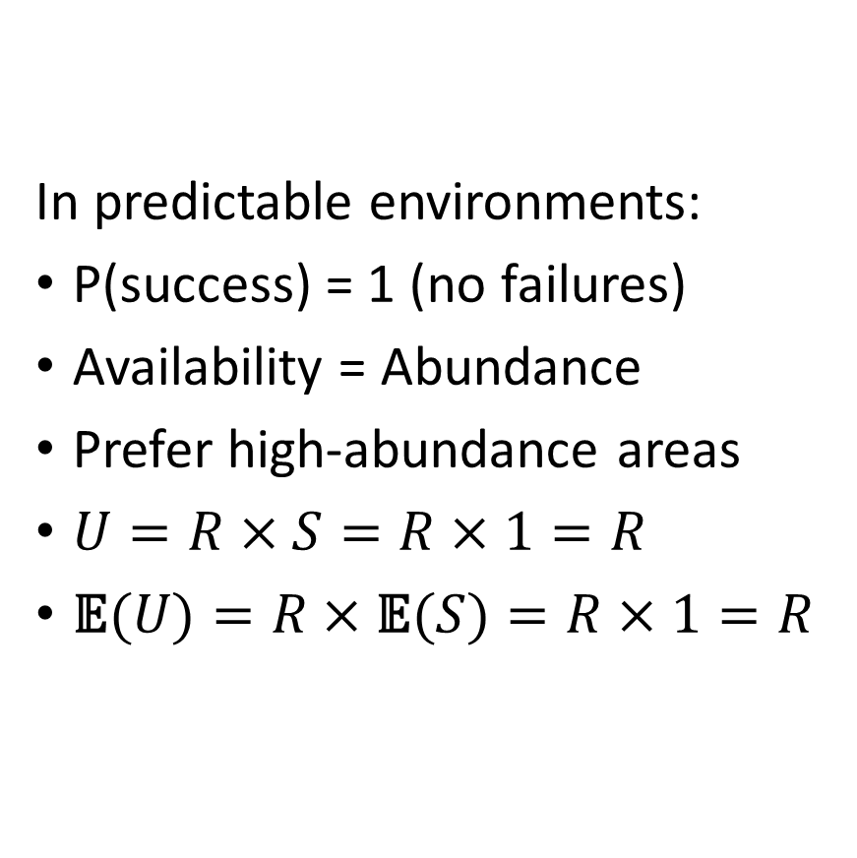
Stable environments --> stable needs
In predictable environments:
P(success) = 1 (no failures)
Availability = Abundance
Prefer high-abundance areas
$U=R×S=R×1=R$
$\text{𝔼}(U)=R×\text{𝔼}(S)=R×1=R$

Slide 27
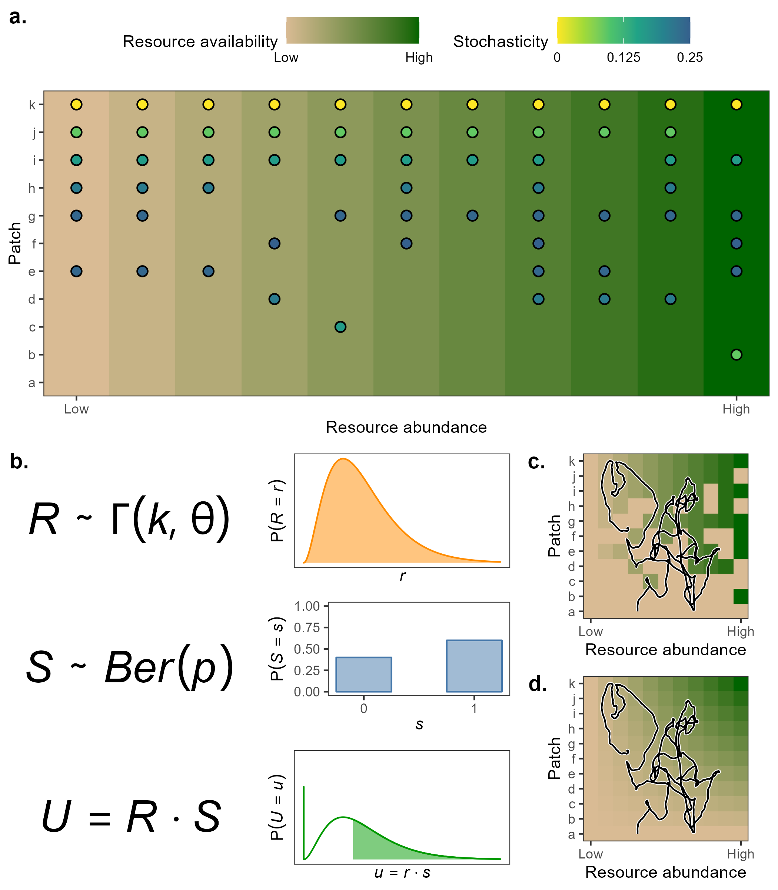
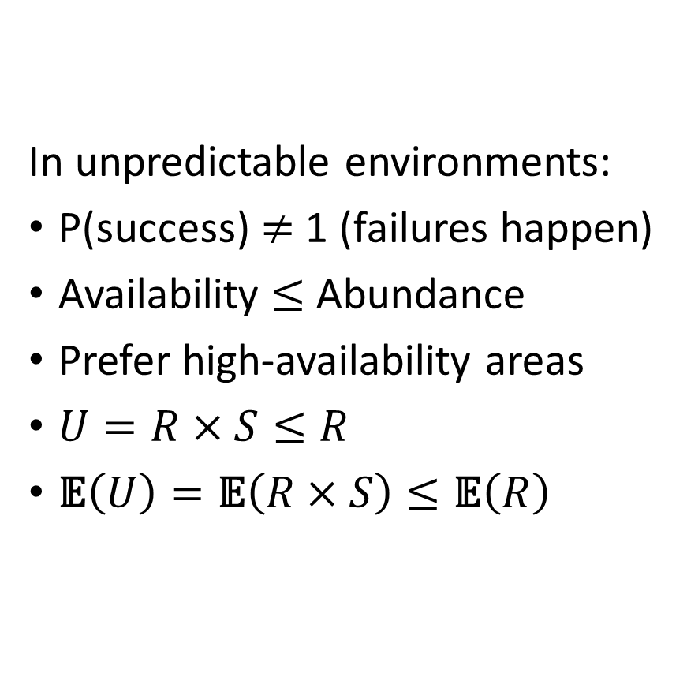
Variable environments --> variable needs
In unpredictable environments:
P(success) $≠$ 1 (failures happen)
Availability $≤$Abundance
Prefer high-availability areas
$U=R×S≤R$
$\text{𝔼}\left(U\right)=\text{𝔼}\left(R×S\right)≤\text{𝔼}\left(R\right)$

Slide 28
Simulating movement

Slide 29
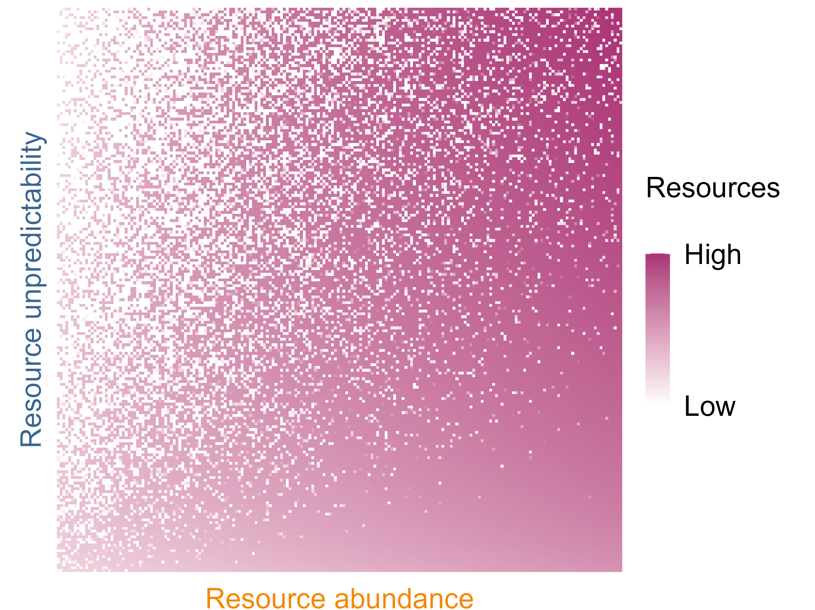
Simulating animal movement

Slide 30
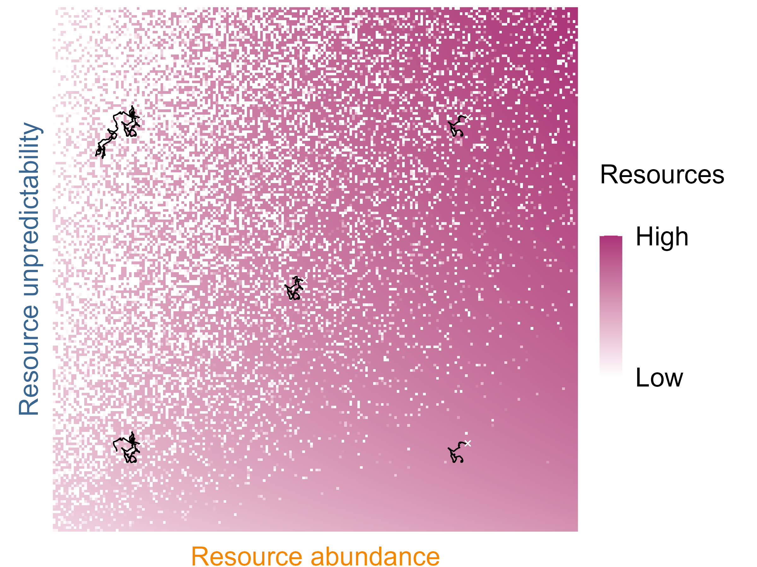
Simulating animal movement

Slide 31
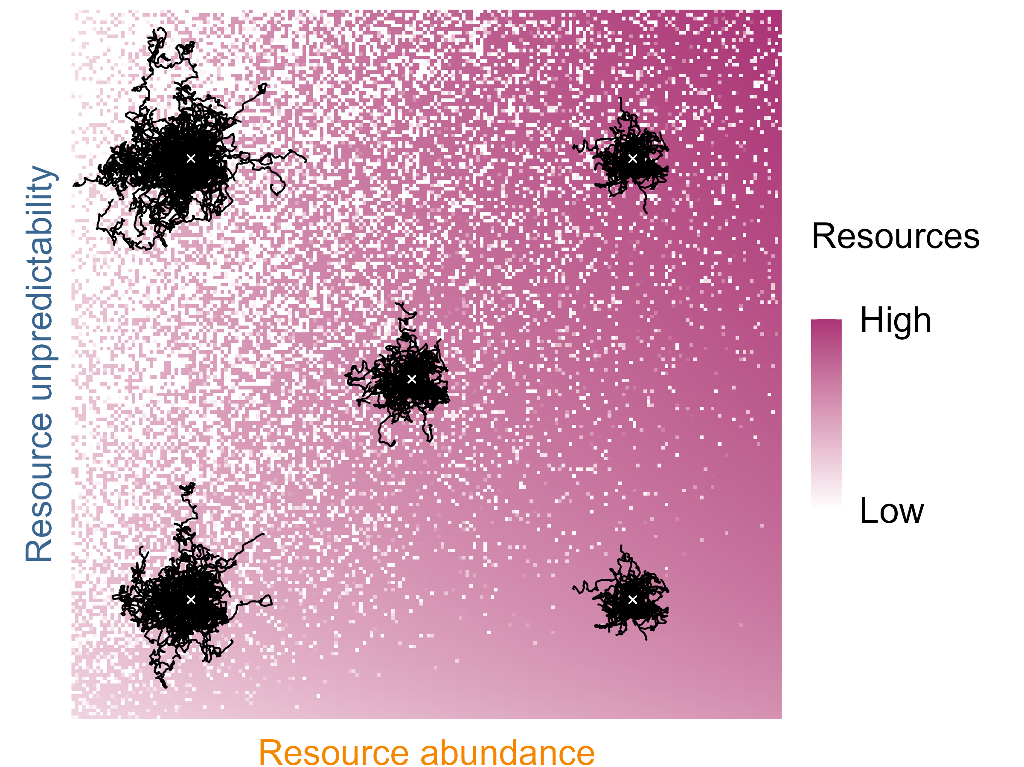
Simulating animal movement

Slide 32
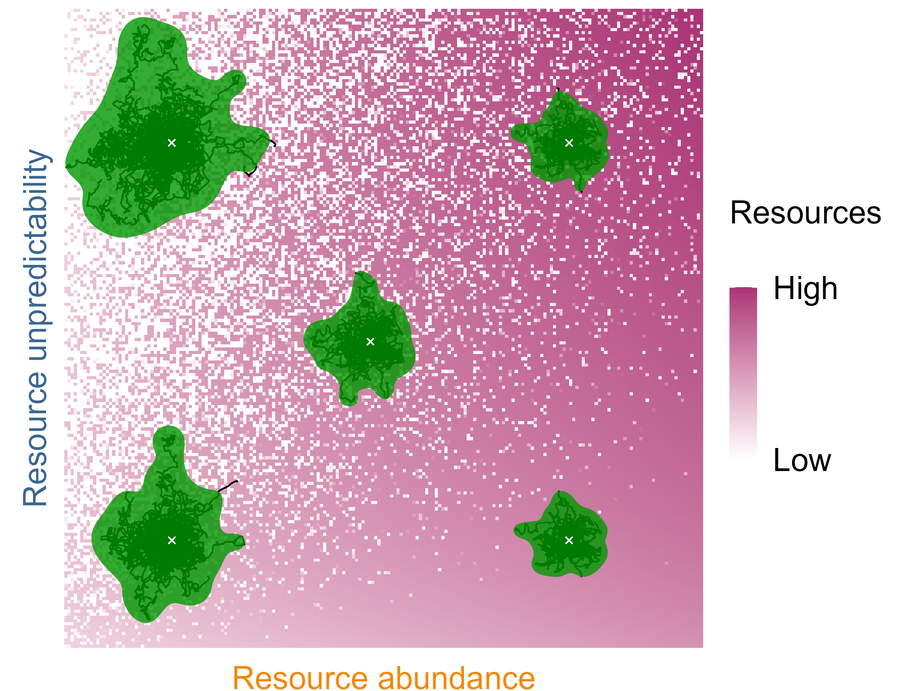
Simulating animal movement

Slide 33
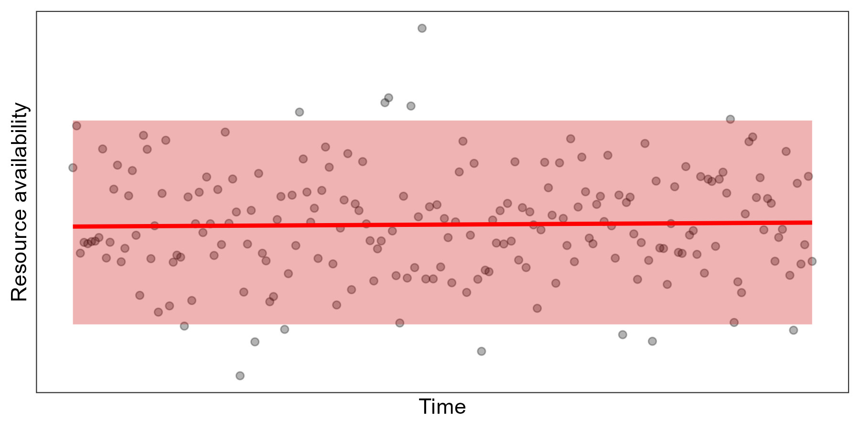
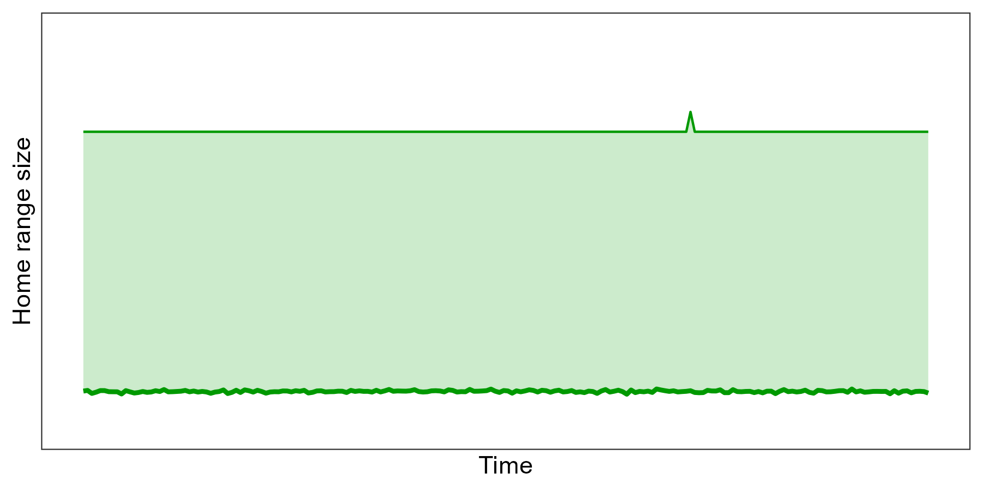
Stationary environments --> constant HR
Constant mean
Constant variance
HR remains constant over time

Slide 34
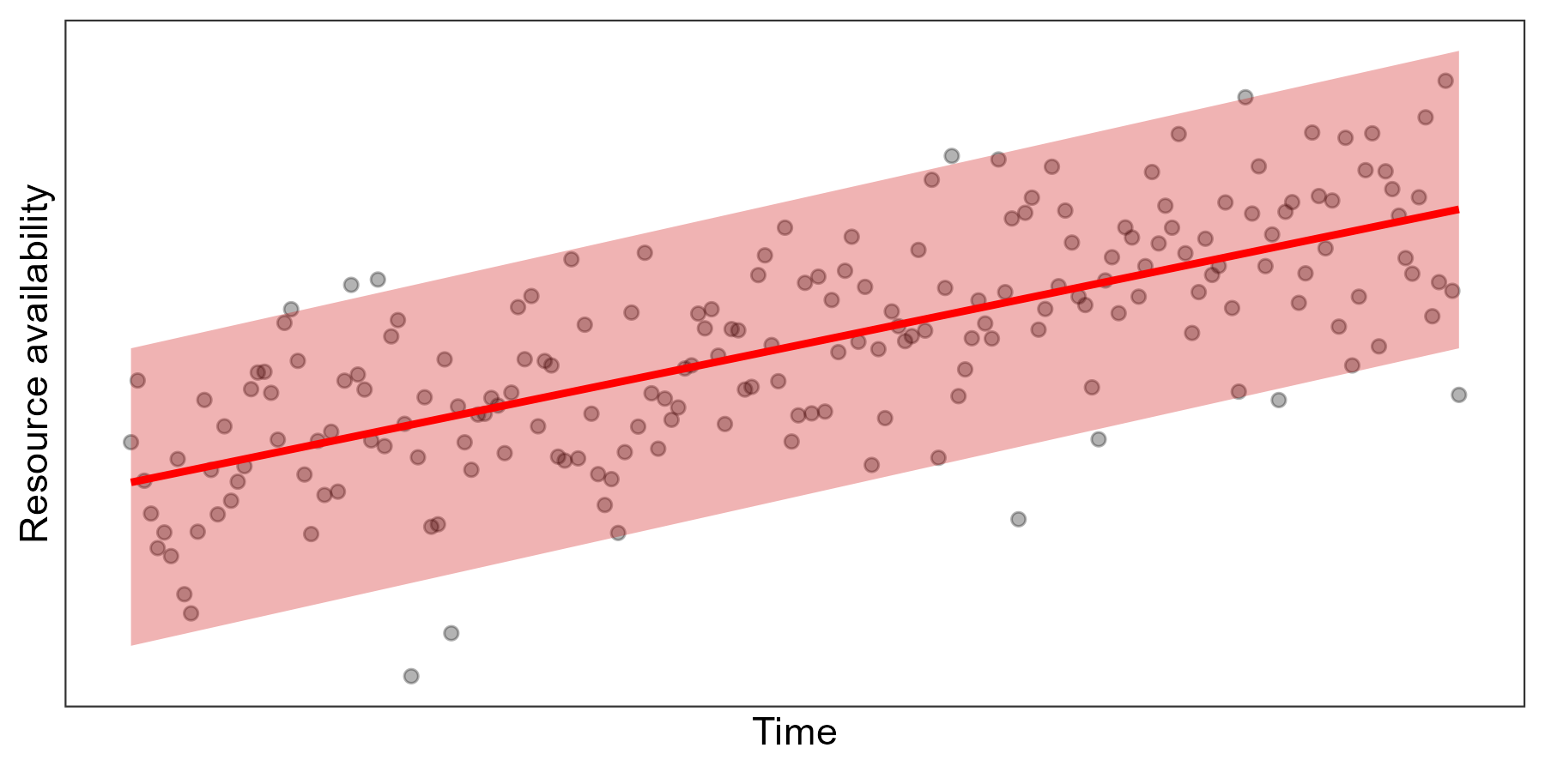
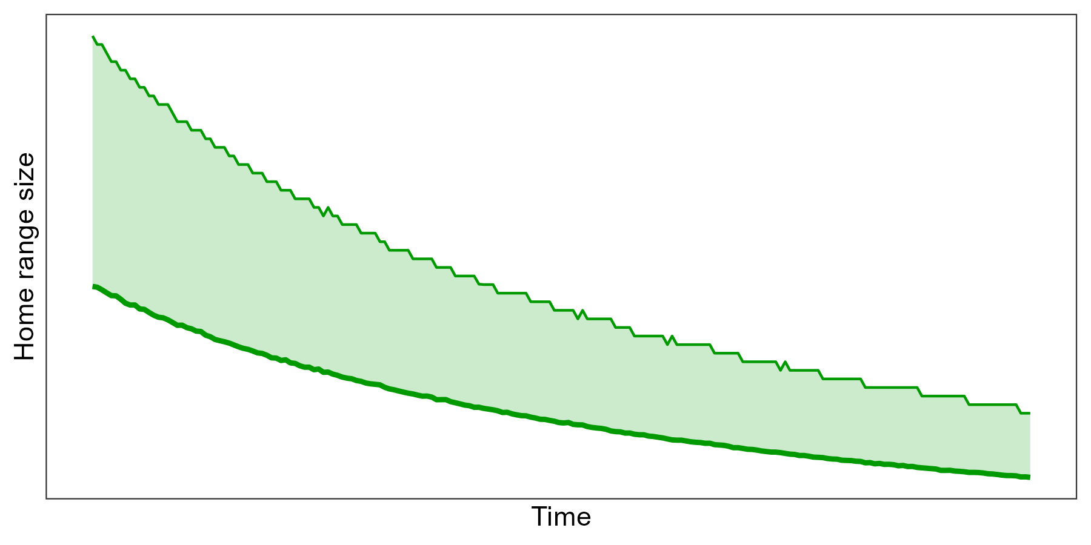
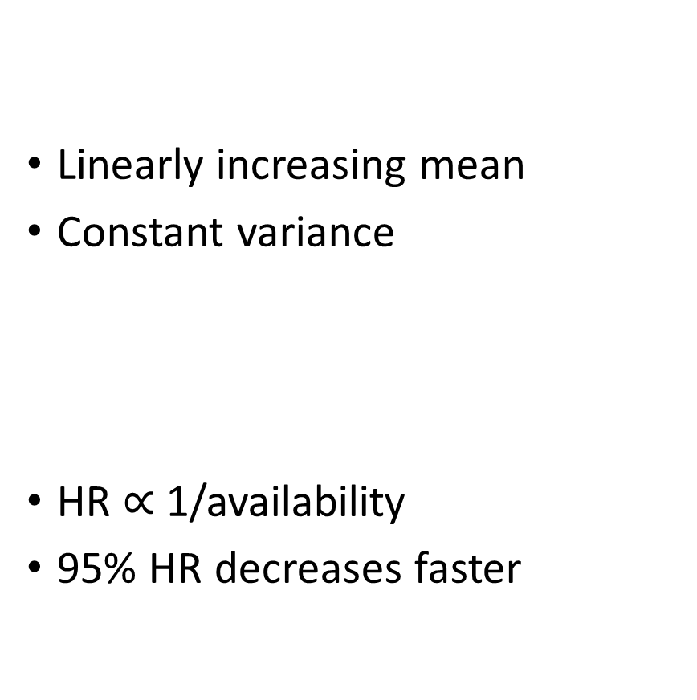
Changing mean --> HR changes rapidly
Linearly increasing mean
Constant variance
HR $∝$ 1/availability
95% HR decreases faster

Slide 35
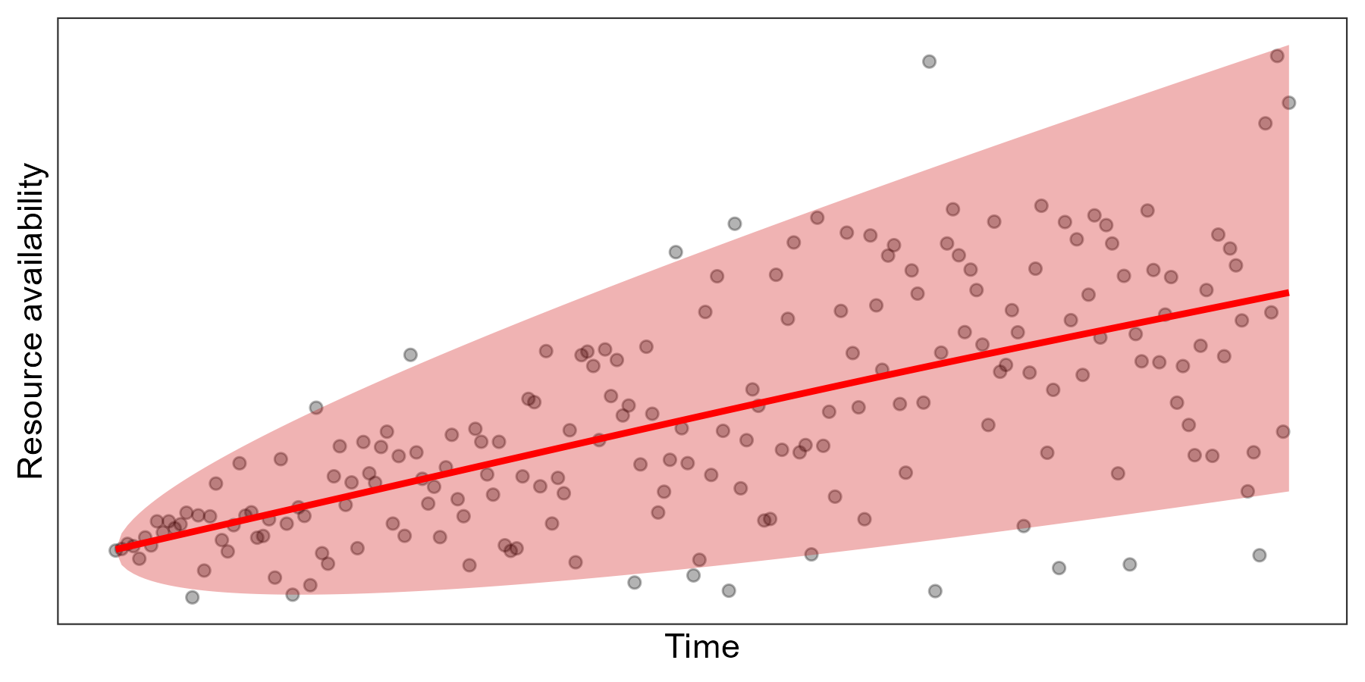
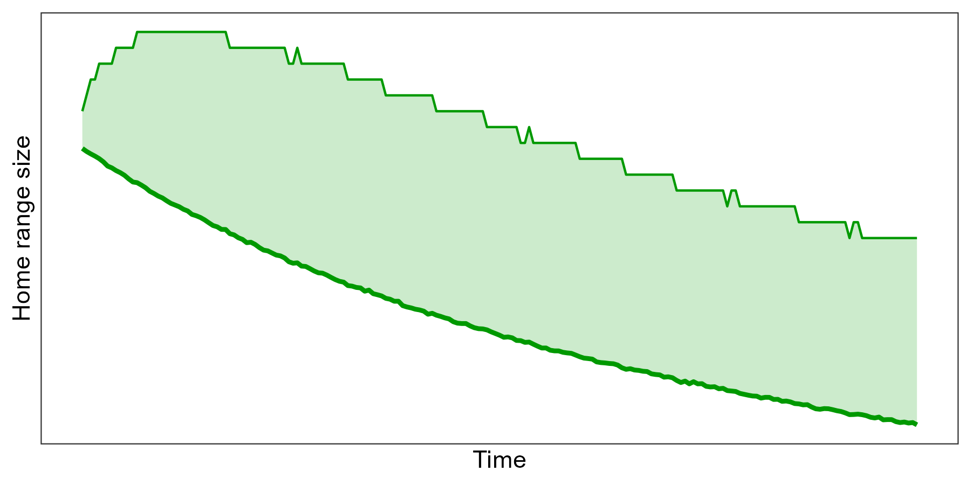
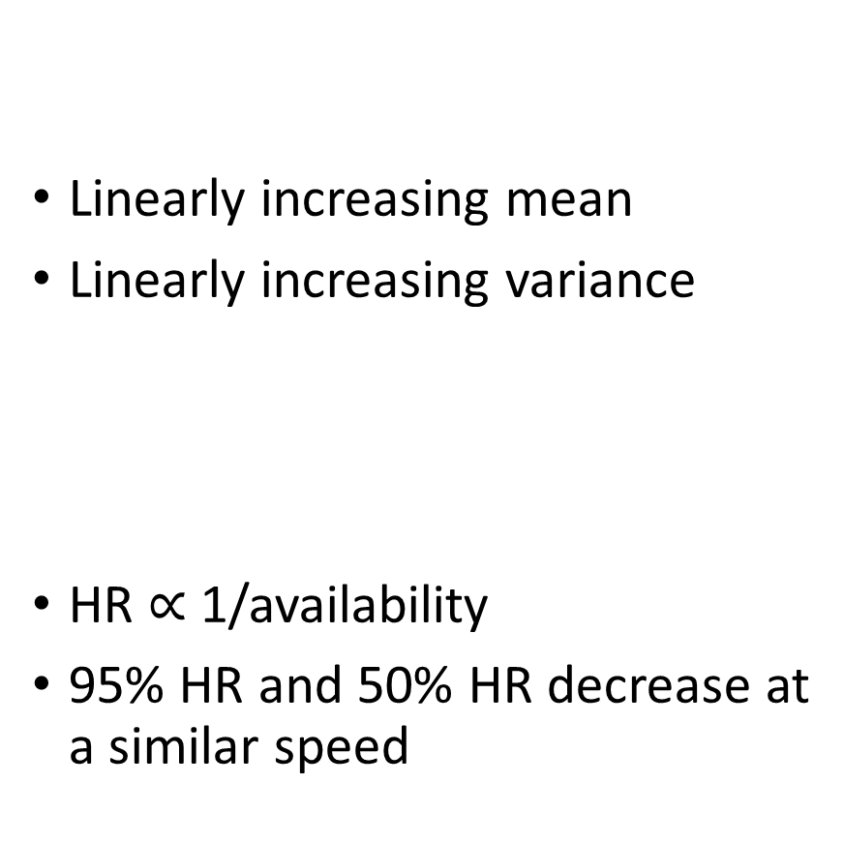
Changing mean and variance --> HR can change slowly
Linearly increasing mean
Linearly increasing variance
HR $∝$ 1/availability
95% HR and 50% HR decrease at a similar speed

Slide 36
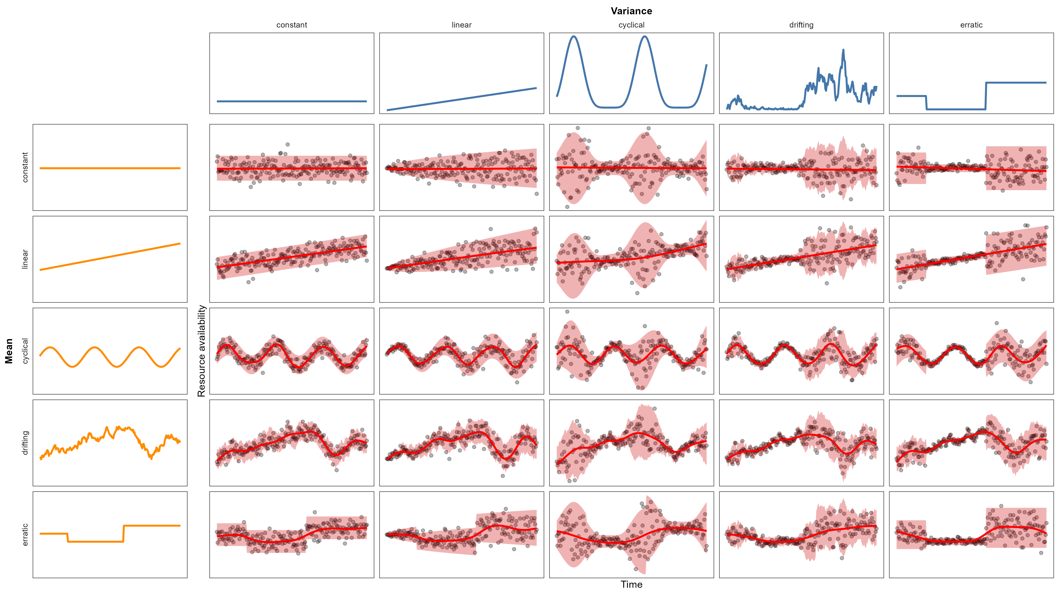
Relationships can be complicated…

Slide 37
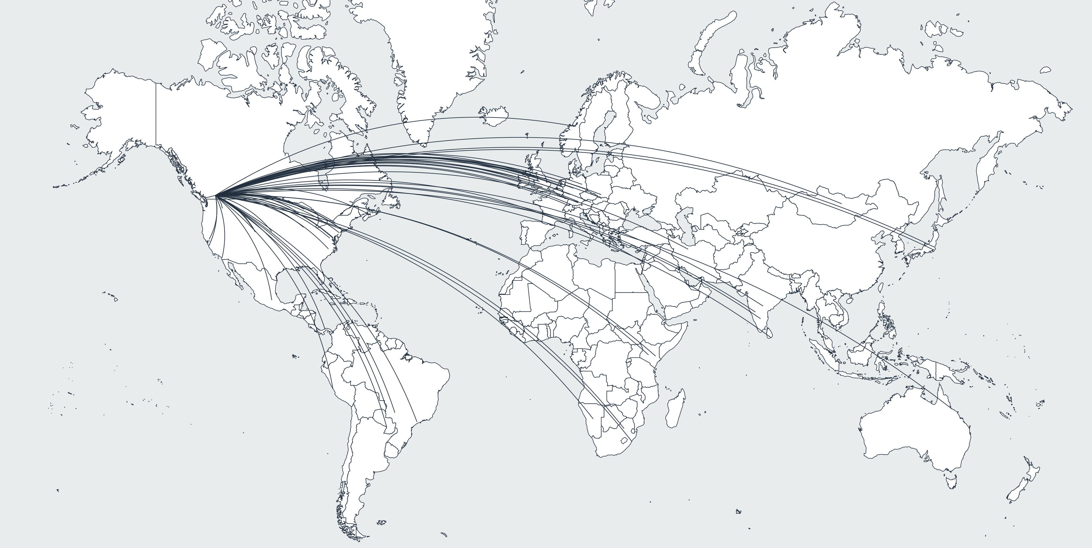
Modeling it all
Movebank dataset:
> 3000 animals
> 85 species
New global raster of environmental variance
Continuous time movement models (ctmm R package)
Hierarchical modeling for common trends (mgcv R package)

Slide 38
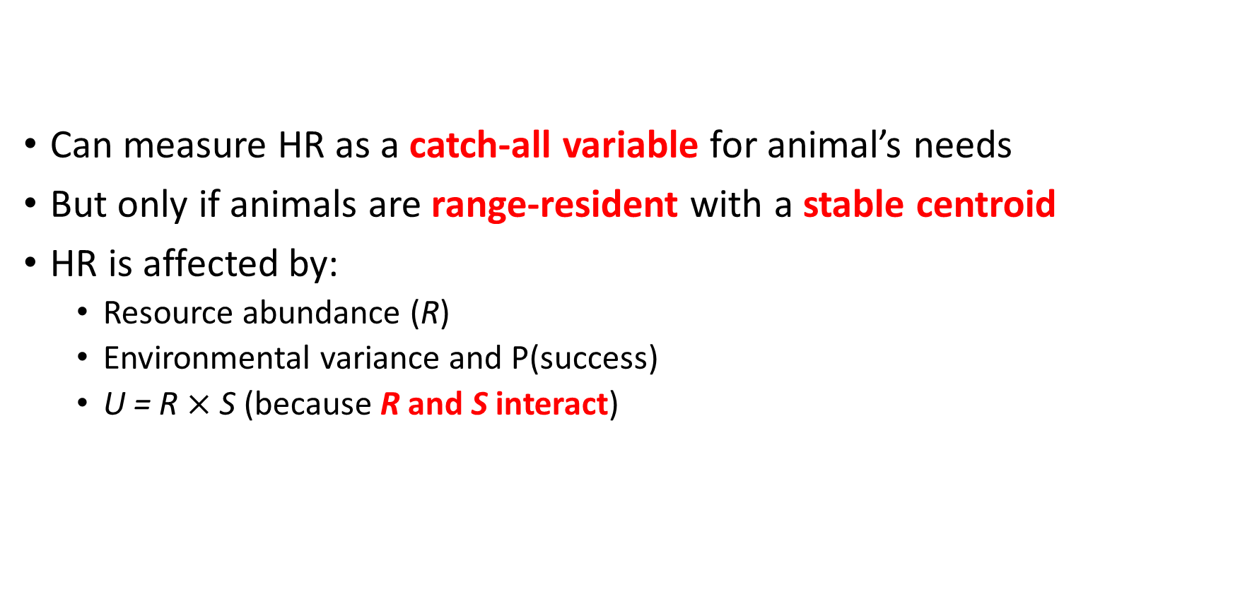
Summary
Can measure HR as a catch-all variable for animal’s needs
But only if animals are range-resident with a stable centroid
HR is affected by:
Resource abundance (R)
Environmental variance and P(success)
U = R $×$ S (because R and S interact)

Slide 39



Funder acknowledgements

Slide 40

Summary
Can measure HR as a catch-all variable for animal’s needs
But only if animals are range-resident with a stable centroid
HR is affected by:
Resource abundance (R)
Environmental variance and P(success)
U = R $×$ S (because R and S interact)
Stefano Mezzini – M.Sc. Biol.
stefano.mezzini@ubc.ca

Slide 41
References
Bengsen A.J., Algar D., Ballard G., Buckmaster T., Comer S., Fleming P.J.S., et al. (2016). Feral cat home-range size varies predictably with landscape productivity and population density. Journal of Zoology 298, 112–120. https://doi.org/10.1111/jzo.12290
Geremia C., Merkle J.A., Eacker D.R., Wallen R.L., White P.J., Hebblewhite M., et al. (2019). Migrating bison engineer the green wave. Proceedings of the National Academy of Sciences 116, 25707–25713. https://doi.org/10.1073/pnas.1913783116
Lucherini M. & Lovari S. (1996). Habitat richness affects home range size in the red fox Vulpes vulpes. Behavioural Processes 36, 103–105. https://doi.org/10.1016/0376-6357(95)00018-6
Nilsen E.B., Herfindal I. & Linnell J.D.C. (2005). Can intra-specific variation in carnivore home-range size be explained using remote-sensing estimates of environmental productivity? Écoscience 12, 68–75. https://doi.org/10.2980/i1195-6860-12-1-68.1
Rizzuto M., Leroux S.J., Vander Wal E., Richmond I.C., Heckford T.R., Balluffi-Fry J., et al. (2021). Forage stoichiometry predicts the home range size of a small terrestrial herbivore. Oecologia 197, 327–338. https://doi.org/10.1007/s00442-021-04965-0

